Slide 1
Quick Write:
Think about things you love or hate:
--a person you love or hate
--a food you love or hate
--a place you love or hate
--an activity or chore…
Explain why.
Are there people, foods, places, etc. that you love AND hate? Why? How can love and hate be so connected?
Why?

Slide 2
Sonnet A fourteen-line lyric poem that is usually written in iambic pentameter and that has one of several rhyme schemes.
Petrarchan (Italian) Sonnet:
Named after Francis Petrarch (1304-1374)
He wrote over 1000 love sonnets about a woman that he may never have spoken with, supposedly named Laura, seen at church
Petrarch used traditional ideals of romantic love and beauty in his sonnets.

Slide 3
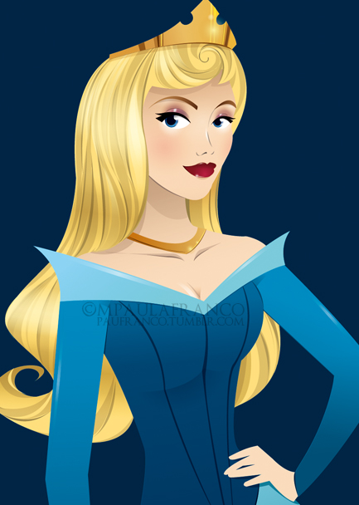
Traditional Conventions of Beauty:
blond hair
blue eyes
pale skin
red lips

Slide 4
Traditional Conventions of Romantic Love:
love is necessary and uncontrollable
not returned or unattainable
painful
often includes oxymoronic expressions like “freezing fire” and “imprisoned freedom”
often compared object of love with nature

Slide 5
Petrarchan (Italian) sonnet
an 8-line unit (octet) that poses a question or problem and a 6-line unit (sestet) that responds (14 lines total). Usually rhymes as follows:
a
b
b
a
a
b
b
a
c
d
e
c
d
e

Slide 6
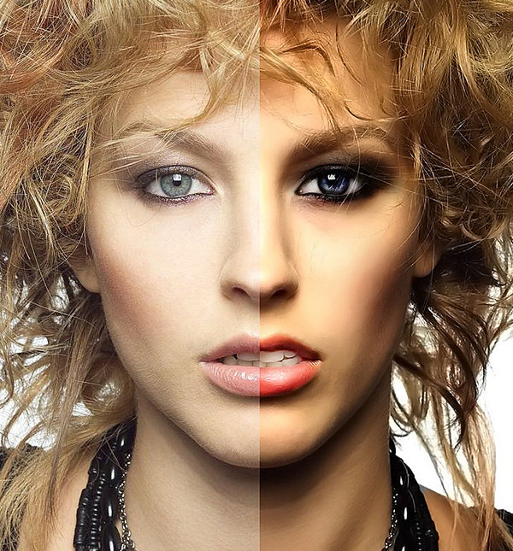
Shakespearean (English) Sonnet Shakespeare played with traditional conventions of love and beauty, while making fun of the old conventions.

Slide 7
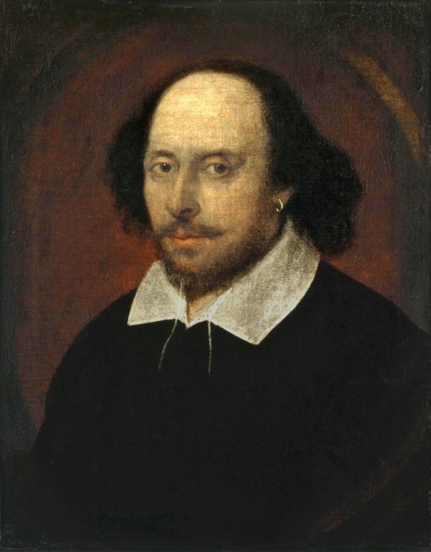
Shakespearean Sonnet:
3 4-line units (quatrains) followed by a heroic couplet (2 lines of iambic pentameter that rhyme).
Quatrains identify and examine a problem.
Couplet provides resolution to problem or a “turn” Rhymes:
a
b
a
b
c
d
c
d
e
f
e
F
g
g

Slide 8
Group Work with sonnets: Answer these questions about your sonnet:
Paraphrase what’s going on in the poem (chunk it!)
What is the poet’s tone/attitude about love? Give examples to back up your answer.
Categorize what type of love it is (intimate/romantic, friendship, true love, lust, “luv”, etc.).
Respond personally to this view of love. Do you agree or not? Why? Is it real love to you?
What kind of person is the speaker or author of the poem? Why do you say that?

Slide 9
Other Poetry terms
rhythm—the alternation of stressed and unstressed syllable in language (occurs naturally)
meter—a regular pattern of stressed and unstressed syllable in a poem
iambic pentameter—
a pattern of first an unstressed and then a stressed syllable, repeated five times.
In fair Ve-ron-a where we lay our scene
Where ci-vil blood makes ci-vil hands un-clean.
Blank Verse—lines of iambic pentameter that do NOT rhyme
Heroic couplet—2 lines of iambic pentameter that rhyme. They end a sonnet.
Soliloquy—a monologue where one person is alone on stage
Aside—when an actor/actress speaks to another character or audience without others hearing. It adds to the dramatic irony.
Foil—a character whose qualities or actions serve to emphasize those of another by providing a strong contrast with them

