Slide 1
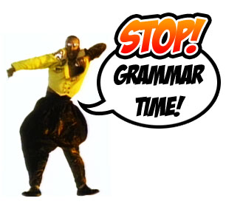
Parts of the sentence
subject
predicate
direct object
indirect object
subject complement

Slide 2
Sentence:
Definition: A group of words that contains a subject and its predicate, and makes a complete thought.

Slide 3
Fragment
An incomplete thought
AVOID FRAGMENTS. IN YOUR WRITING! Hahaha!
Avoid fragments in your writing!

Slide 4
SUBJECT
The noun or subject pronoun that the sentence is about.

Slide 5
Subject pronouns: (I, you, he, she, it, we, you, they)
Can be sentence subjects!
He and I entered the turkey trot, NOT: Him and I entered the turkey trot.

Slide 6
Compound subject is a double subject; more than one noun or pronoun used as a double subject of the same clause
Physics and astronomy ARE my favorite classes.
Coordinating conjunction AND is plural: Jake and Cy ARE here.
Coordinating conjunction OR is singular: Michael or Seth IS here.

Slide 7
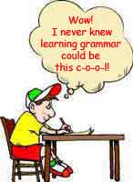
Predicate
The verb and other words that are about the subject

Slide 8
Subjects and predicates must agree in number
Mountains ARE…
The mountain IS…
The top of the mountains is covered by snow.

Slide 9
Direct object
A noun or object pronoun that receives the action of the action verb. (AVP)

Slide 10
Indirect object
A noun or object pronoun between the action verb (AVP) and the direct object, that is indirectly affected by the action.
The structure is S--AVP--IO--DO.

Slide 11
Subject complement, not compliment
the noun, subject pronoun, or adjective that is linked to the subject by a linking verb (LVP), and that tells more about the subject.
It is linked to the subject by a linking verb (LVP).
To complement something is to complete it!
Example: Heidi is Alex’s friend.

Slide 12
LOGIC?
Find the subject and predicate
Is the verb action (AVP) or linking (LVP)?
If verb is action then, look for a DO. If you find a DO, look for a IO.
If the verb is linking then, look for a subject complement.
Subject pronouns are subjects! DUH!
(see why knowing the parts of speech, including subject and object pronouns, is important?)
Object pronouns are objects! DUH!

